Slide 1
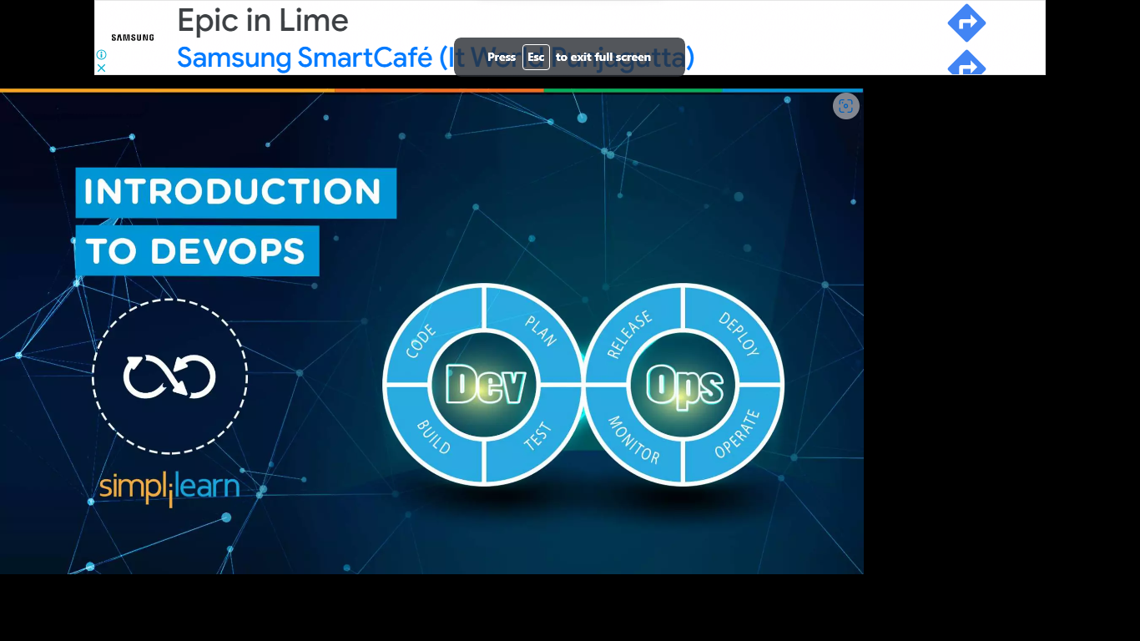
Introduction to DevOps

Slide 2
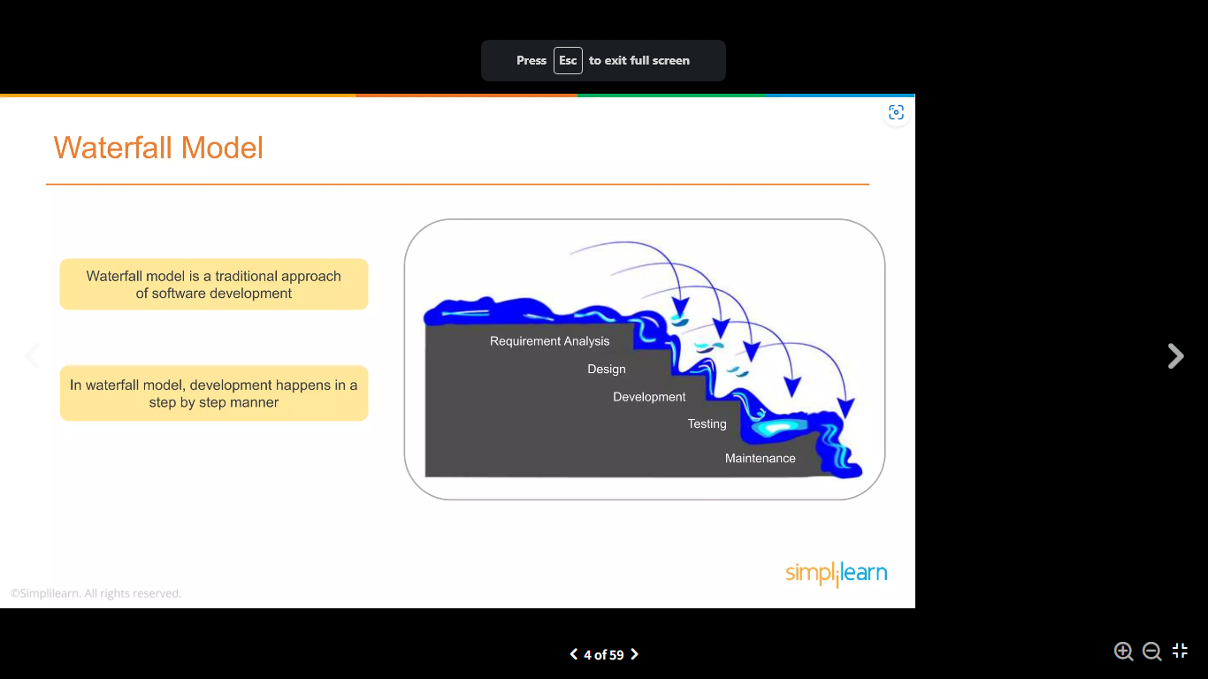

Slide 3
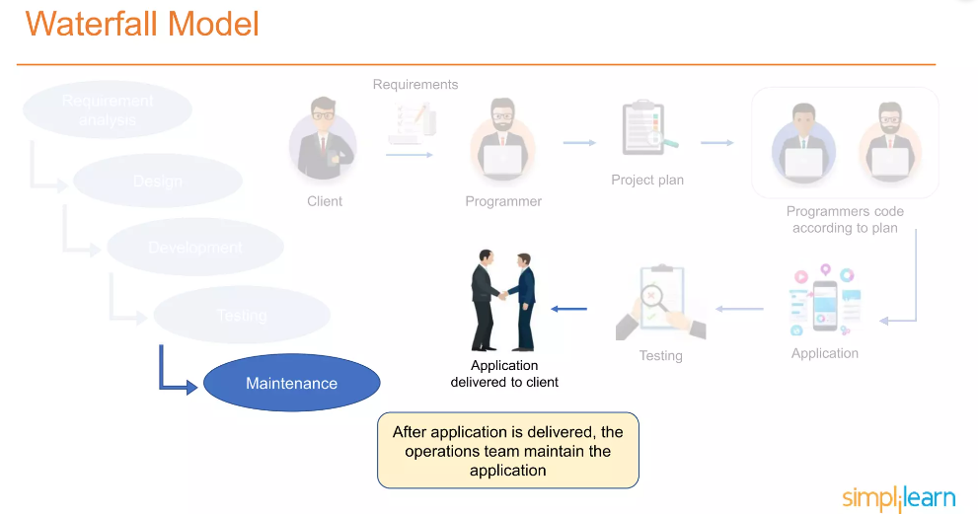







Requirement
Design/Plan
Development
Testing

Slide 4
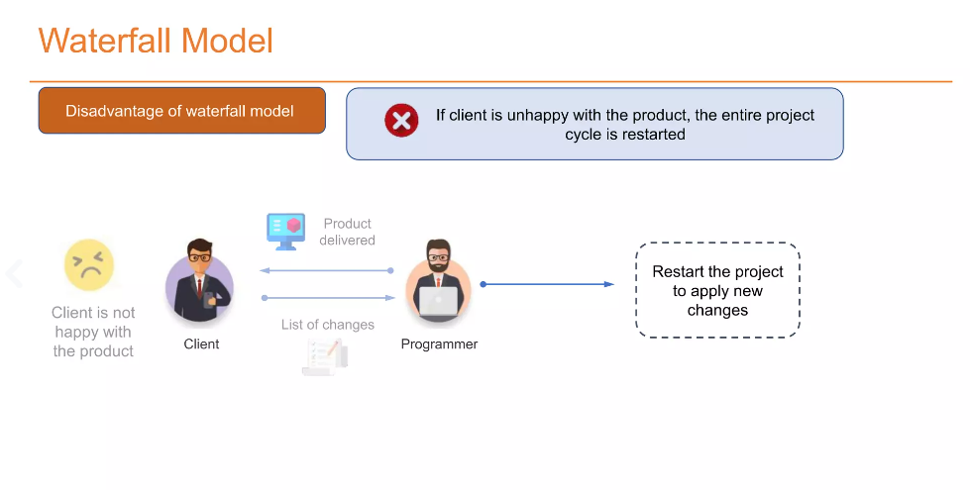
Any new requirements from the client will restart the development cycle

Slide 5
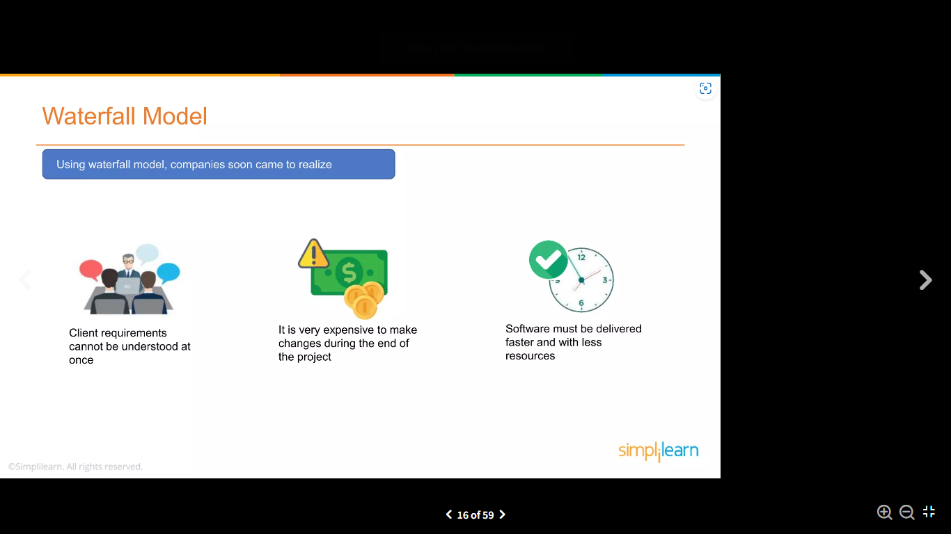

Slide 6
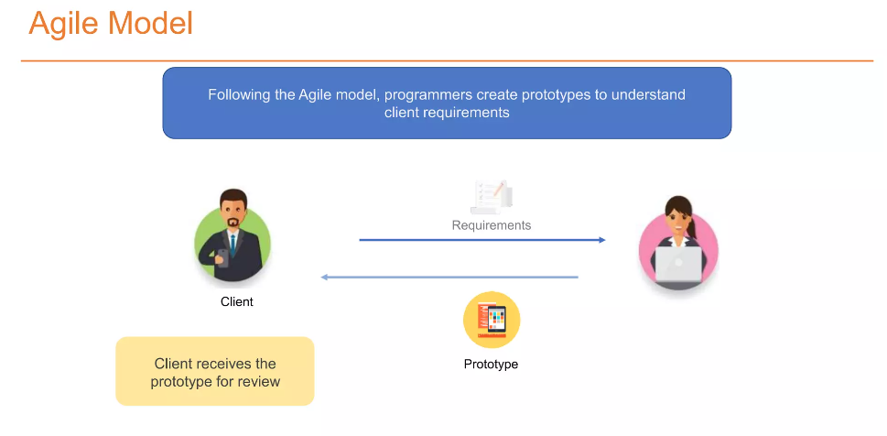
Add a Slide Title - 1
Client provides the feedback and list of changes to be made

Slide 7
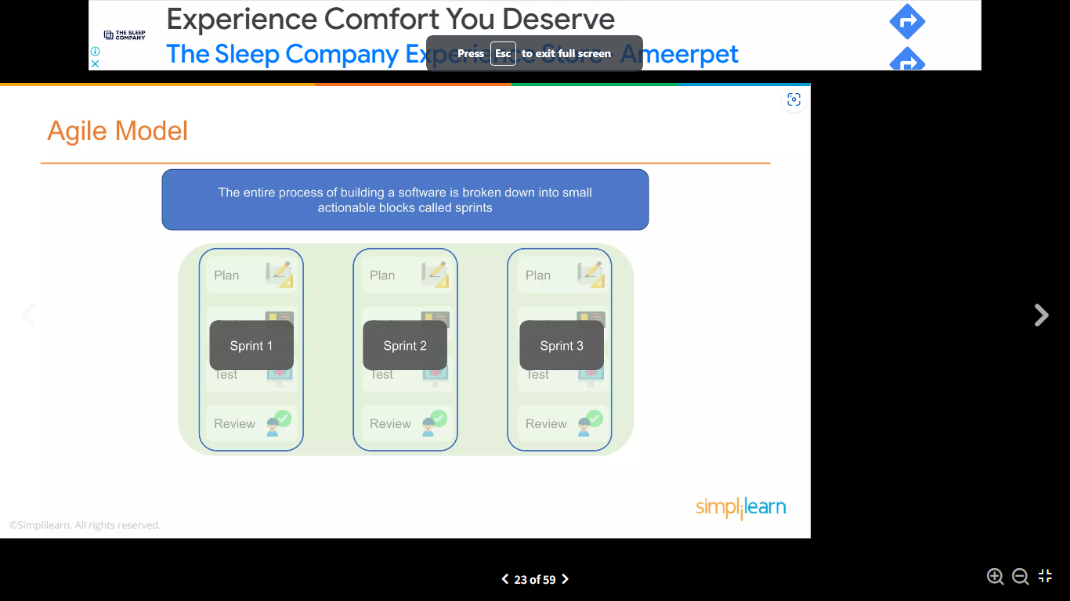
Add a Slide Title - 2

Slide 8
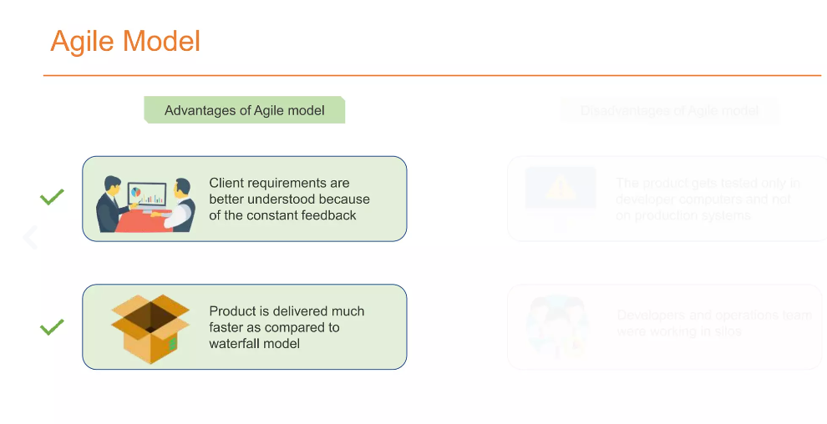
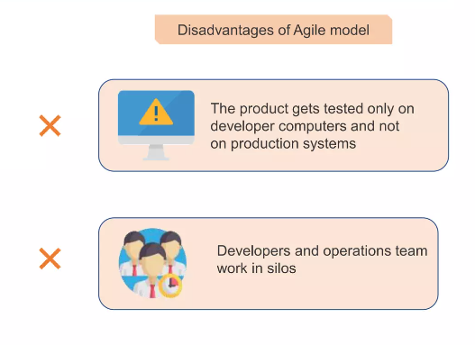

Slide 9
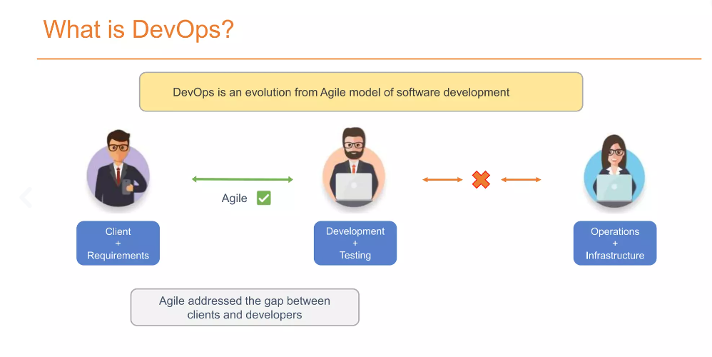
Developers submit the product to operations for Deployment
When the product fails in the production servers, the operations team is clueless and sends the product back to the developers

Slide 10
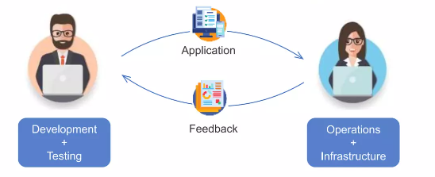
DevOps addressed the gap between Developers and Operations
Updating the code, adding new features, and resolving bugs, running unit tests, pushing the code to production, and monitoring its performance. Writing, testing and reviewing code by Development team members.
The operations team ensures that features are running smoothly and that there are no interruptions in service. They also maintain, monitor, and troubleshoot applications in production environments.

Slide 11
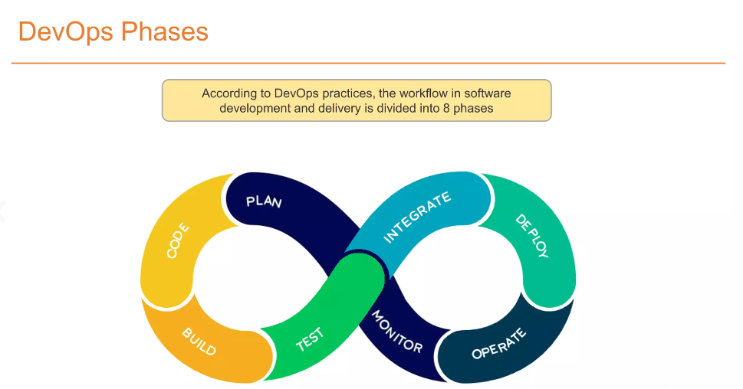
Add a Slide Title - 4

Slide 12
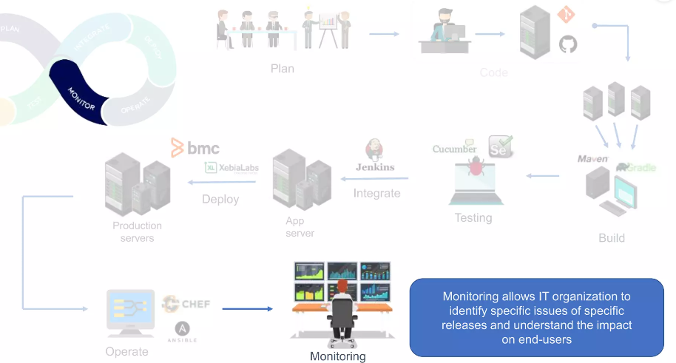
The Business owners and project development team discuss project goals and creates a plan
Programmers use various tools to develop the code
We test the application and integrate it with the already existing code base
By using build tools, we take code from different repositories to make a complete application
Application is moved from development to production environment

Slide 13
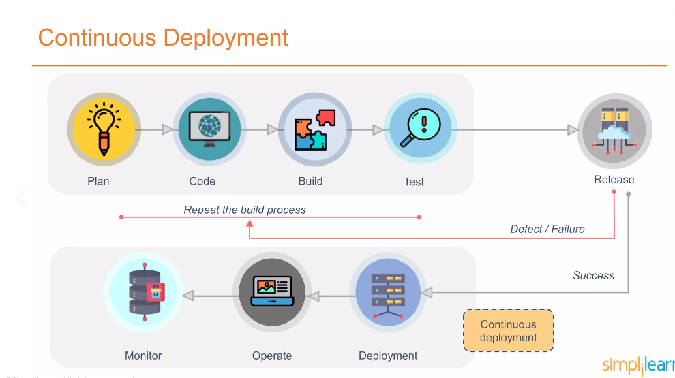
Continuous Delivery, Continuous Integration, Continuous Deployment
Continuous Delivery
Continuous Integration

Slide 14
